Slide 1
Introduction To Web Development

Slide 2
Introduction
Web development is the process of creating, building, and maintaining websites. It involves various aspects such as web design, web programming, web publishing, and database management
Web developers are responsible for building and maintaining websites, ensuring that they are functional, user-friendly, and visually appealing

Slide 3
There are three main types of web developers:
Front-end developers: They work on the client-side of the website, focusing on the user interface, content presentation, and user experience. They use HTML, CSS, JavaScript, and relevant frameworks to create the front-end of a website
Back-end developers: They work on the server-side of the website, handling the behind-the-scenes functionality, data storage, and processing. They use server-side programming languages, frameworks, and database technologies to build the back-end of a website
Full-stack developers: They have knowledge and skills in both front-end and back-end development, allowing them to work on all aspects of a website

Slide 4
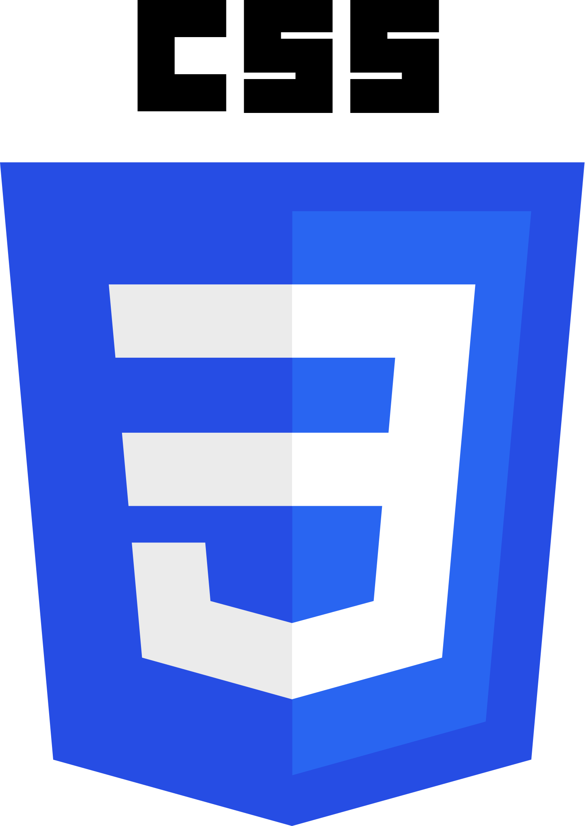
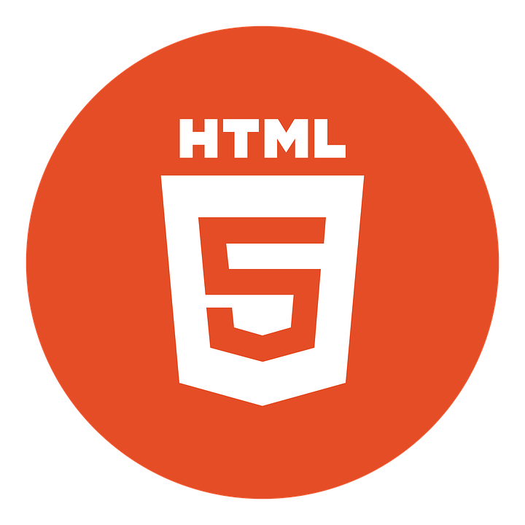

Tools And Technologies
Essential Frontend Technologies

Slide 5
Tools And Technologies
HTML5 is the fifth and latest version of the HTML standard for creating web pages. It was officially released in 2014 and is currently the most widely used version of HTML.
Here are three key points about HTML5:
Improved multimedia support: HTML5 includes built-in support for video and audio, making it easier to embed media content into web pages without the need for third-party plugins like Flash
Semantic markup: HTML5 introduces new semantic elements like <header>, <nav>, <article>, and <footer> that provide more context and meaning to web page content, making it easier for search engines to index and categorize pages
Mobile-friendly: HTML5 is designed to work well on mobile devices, with features like responsive design, touch support, and location-based services

Slide 6
Tools And Technologies
CSS3 is the third version of the CSS standard: CSS3, also known as Cascading Style Sheets Level 3, is the latest iteration of the CSS standard used for styling and formatting web pages.Unlike previous versions, CSS3 is divided into separate documents called "modules," each adding new capabilities or extending features defined in CSS2 while preserving backward compatibility.
CSS3 offers advanced features and improvements: CSS3 incorporates the CSS2 standard with various enhancements, making it more powerful and easier to learn and understand. Some of the advanced features in CSS3 include flexible box layout, grid layout, animations, transitions, and support for media queries, which allow for responsive design
CSS3 modules cover different aspects of web design: The CSS3 specification is divided into multiple modules, each focusing on a specific aspect of web design, such as colors, typography, layout, and animations. This modular approach allows for more efficient development and release of recommendations, as different CSS modules can progress at different rates
.

Slide 7
Tools and Technologies
JavaScript is a versatile and widely-used programming language that powers interactive and dynamic web experiences. It allows developers to create dynamic and interactive content on websites by manipulating HTML and CSS elements.
Dynamic and interactive web content: JavaScript is a scripting language that enables you to create dynamically updating content, control multimedia, animate images, and more. It is used to add interactivity to web pages, allowing for features like dropdown menus, animated graphics, and dynamic background colors
Versatility and compatibility: JavaScript is compatible with other languages like PHP, Perl, and Java, making it a versatile choice for developers. It is a multi-paradigm language, supporting event-driven, functional, and imperative programming styles. JavaScript can be used for both client-side and server-side development
Widespread adoption and popularity: JavaScript is one of the core technologies of the World Wide Web, alongside HTML and CSS

Slide 8

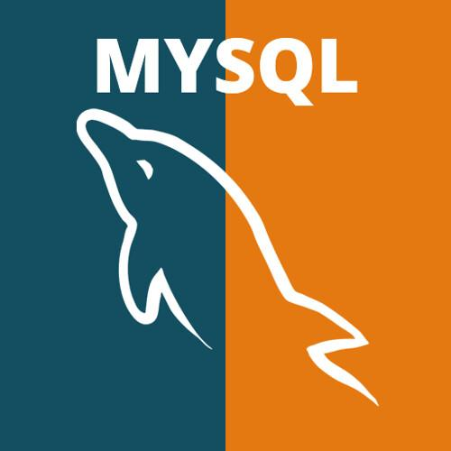


Tools and Technologies
Essential Backend Technologies

Slide 9
Tools and Technologies
MySQL is a popular open-source relational database management system (RDBMS) that is widely used for managing databases.
Structured data management: MySQL is designed to manage structured data, which is data that is organized into tables and columns. It uses Structured Query Language (SQL) to interact with databases, allowing users to add, modify, and retrieve data from tables
Modular architecture: MySQL has a modular architecture that allows users to choose from different storage engines, each with its own strengths and weaknesses. The default storage engine is InnoDB, which is optimized for transactional workloads and provides features like row-level locking and foreign key constraints
Open-source and community-driven: MySQL is an open-source project, which means that the source code is freely available for anyone to use, modify, and distribute. It has a large and active community of developers and users who contribute to its development, support, and documentation

Slide 10
Tools and Technologies
PHP, which stands for Hypertext Preprocessor, is a popular server-side scripting language primarily used for web development
Dynamic and interactive web content: PHP allows developers to create dynamic and interactive web pages by embedding PHP code within HTML. It can be used to generate dynamic content, handle form processing, and interact with databases.
Open-source and community-driven: PHP is an open-source language, meaning its source code is freely available for anyone to use, modify, and distribute. It has a large and active community of developers and users who contribute to its development, support, and documentation.
Versatility and compatibility: PHP is a versatile language that can be used on various platforms and web servers. It is compatible with different databases like MySQL, Oracle, and PostgreSQL, making it a popular choice for web applications that require database integration

Slide 11
Tools and Technologies
Ruby on Rails, often referred to as Rails, is a popular web application development framework written in the Ruby programming language.
Convention over Configuration (CoC): Rails follows the principle of Convention over Configuration, which means it has opinions about the best way to do things in a web application and defaults to a set of conventions. This approach allows developers to write less code while accomplishing more, making web application development faster and more efficient
MVC Architecture and DRY Principle: Rails follows the Model-View-Controller (MVC) architectural pattern and emphasizes the use of the Don't Repeat Yourself (DRY) principle. The MVC pattern separates the application's data, presentation, and logic, making it easier to maintain and update
Built-in Testing and Scaffolding: Ruby on Rails provides a built-in testing framework that allows developers to write tests for their code, saving time and effort. Additionally, Rails offers a scaffolding feature that generates a basic set of files and code for a new application, helping developers get started quickly and efficiently

